Slide 1
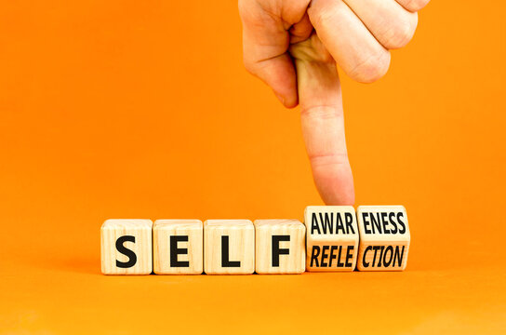
The bias mirror
Who do I naturally gravitate toward at work?
Who do I unintentionally overlook or find challenging to connect with?
Have I ever made assumptions based on someone’s accent, tone, appearance, age, gender or background? What was the impact?
Notes:
J
Reflective exercise on bias
Take two muites and answer all questions
Group Self-reflection and reflection with others
Share anywer for 5 minutes with someone else
Group of 4 and take 10 minutes to discuss each question
One person to share feedback to larger group. 10 minutes to share in larger group
This activity is helping you to check in on your own bias, while having brave conversations.

